Slide 1


DAB 401-Financial Analytics
Group Members
Abdul hannan
amith john varkey
mohammad hashim
Delta joseph
bhavya vinod

Slide 2


FINANCIAL STATEMENT ANALYSIS

Slide 3
Objective
Scenario
Introduction
Stage 1 – Eliminate one group
Portfolio Analysis
Results After stage one
Final Stage – Choose the best one
Financial Statement Analysis
Various Financial Ratios
Final Balance statement Results for Apple and IBM respectively
Final Cash Flow statement Results for Apple and IBM respectively
Final Income statement Results for Apple and IBM respectively
Share Price Distribution over the years.
Conclusion
References

Slide 4
SCENERIO
We are a team of data analysts ,and a stakeholder or a company approaches us with concerns regarding where to invest his share or buy the acquisition among the four choices of companies of his interest. So as a team he want us to analyse various financial ratio’s to help him to invest or make an acquisition in the best company among the four.

Slide 5
Introduction
The Stakeholder came up with the four various companies which were Apple Inc, International Business Machines Corporation (IBM), Delta Air Lines Inc (DAL) and The Walt Disney Company (DIS).The objective was to help him choose the best company to invest .
Steps Taken
Four companies were split into group of two. So we made one group with Apple and IBM Companies and another group with Walt Disney and Delta Airlines for analysis. We performed different financial measures like Portfolio Return, Portfolio Risk and Sharp ratio in order to choose the best group among the two groups.
So one group would be eliminated from the above step and Financial Statement Analysis will be done on the other group.

Slide 6

Stage 1 – Eliminate one group

Slide 7
Portfolio Analysis
Portfolio analysis is the evaluation of all the components involved in purpose of decision making ,which are supposed to increase overall return.
Portfolio Return
The return on portfolio refers to the gain or loss of a portfolio of investments including many types of investments.
Portfolio Risk
Portfolio risk is a possibility that the combination of assets or units will fail to achieve financial targets within the portfolios that you own.
Sharpe Ratio
The Sharpe ratio tests the investment's performance against a risk-free asset after modification of its risk.

Slide 8
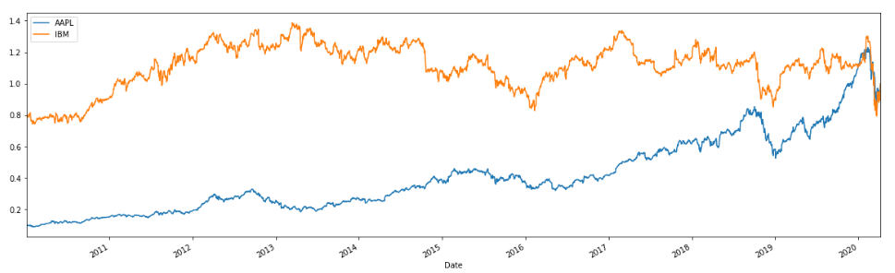
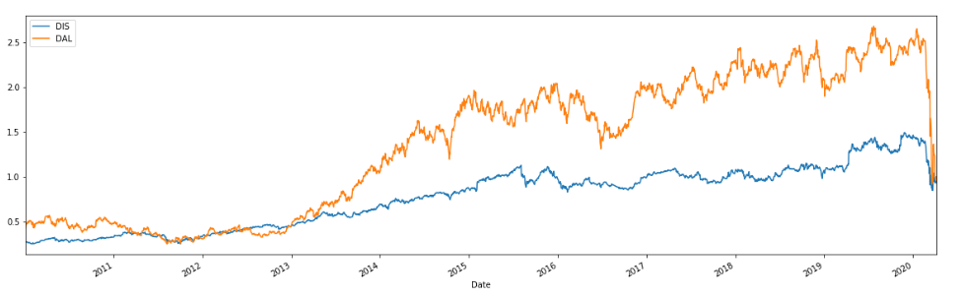

Slide 9
Results after stage one
So the Portfolio return gave us a value of 15.28% for group 1 and 15.45% for group 2 and also the Portfolio risk for group 1 was 0.21 and for group 2 it was 0.26.
Even though the portfolio return was almost the same for both the groups, group 2 had more portfolio risk than group 1. So in order to make it more clear we found out the Sharpe ratio as well.
So the Sharpe ratio had a value of 0.63 for group 1 and 0.50 for group 2, so we can conclude that group 1 was more better than group 2.
So we will be eliminating group 2 ( The Walt Disney and Delta Airlines ) and will be performing financial statement analysis on group 1(Apple Inc and IBM ) in order to get more insights about the company.

Slide 10

Final Stage – Choose the best one

Slide 11

Financial Statement Analysis.
Financial statement analysis means analyzing the company’s financial stability for decision making Financial statement analysis helps external stakeholders and investors to determine the financial performance of the company. Financial statements include balance sheet, income statement and cash flow.
We will be doing Ratio Analysis on different Financial statements in order to analyze which company is performing better.

Slide 12

Income statement
The income statement defines the profit and loss of the company over the time period.
Cash Flow
Cash Flow defines how much revenue the company has received in the time period and how much cash the company spent and how much cash left in the bank.
Balance sheet
Balance sheet defines the current asset and liabilities of a company in a time period .

Slide 13
Various Financial Ratio’s
Asset Turnover
It’s a measure to evaluate the efficiency of the assets a company use by calculating the total revenue for every dollar of company’s asset.
Gross Profit Margin
It’s a measure for assessing financial health of a company by evaluating the money left from sales after reducing the cost of goods sold.
Asset Turnover= Total Revenue ÷ Average Assets for Period
Gross Profit Margin = gross profit ÷ revenue

Slide 14
Operating Margin
It’s the measure of profit company makes on each dollar of sales after variable cost. The variable cost includes cost of raw materials and wage before the payment of tax.
Interest coverage ratio
It is the efficiency of a company to pay it’s interest with it’s unpaid debt.
Net Profit Margin
It’s the evaluation of revenue after reducing all the expenses from the sales.
Operating Margin=Operating Earnings/ Revenue​​
Interest Coverage Ratio=EBIT/Interest Expense​ {EBIT=Earnings before interest and taxes​.}
Net profit margin = (Net profits ÷ Net sales) x 100

Slide 15
ROE (Return on Equity)
It is a metric for company’s net income. It’s also a measure of profitability of a company.
Current Liability Coverage Ratio
It is the measure to evaluate the company’s ability to pay its current liabilities from its operations
ROE = Net Income/ Equity.
Current Liability Coverage ratio = Net cash provided by operating activities/ average current liabilities

Slide 16
Cash Flow Margin Ratio.
It is effectiveness of a company to convert its sales to cash.It is calculated in percentage
Cash Flow Coverage Ratio
It depicts the relationship of a company’s operating cash flow to its total debt
Cash Flow Margin Ratio = Cash flows from operating activities/net sales
Cash Flow Coverage Ratio = operating Cash Flow​/ Total Debt

Slide 17
Working Capital
It is company’s capability to pay its current liabilities with its current assests.
Quick Assets
It’s the assest a company owns that can be easily converted into cash or which is already in cash form.
C & E=cash & equivalents
MS=marketable securities
AR=accounts receivable​
Current Ratio= Current Assets​​-Current Liabilities
Quick Assets = Total current assests – inventory

Slide 18
Acid Test Ratio
It’s a also known as quick ratio ,it evaluates whether the company has enough short-term assests to cover up its shorts-term liabilities.
A/R=Accounts receivable
Debit – Equity - Ratio
It is the ratio of company’s total liability to its shareholder equity
Acid Test Ratio= Quick Assets / Current Liabilities ​
Debt/Equity Ratio = Total Liabilities​​/ /Total Shareholders’ Equity

Slide 19
Current Ratio
It’s a measure to evaluate the capability of company to pay it’s short term liabilities in one year.
Working capital per dollar of sales
It is the amount of working capital that is required to generate one dollar of sale.
Current Ratio= Current assets /Current liabilities
Working capital per dollar of sales = working capital ÷ total sales

Slide 20
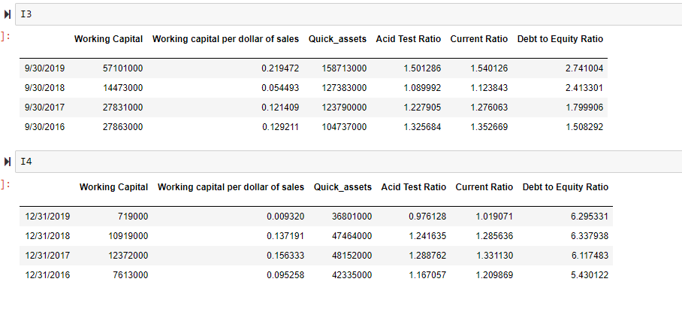

Final Balance statement Results for Apple and IBM respectively

Slide 21
Summary
When we look into balance statement ratio, Apple’s working capital has a surge in growth by last four years. But in other hand, IBM struggle to maintain their working capital.
Working capital per dollar of sales is favorable for IBM because they only expensing .00929320 when they generate one dollar of sale. When we are looking into quick assets, Apple has a remarkable hike in the last four consecutive years. Maybe this is the major reason why apple has a great liquidity. As the test ratio and current ratio is favorable for apple ,so it’s clearly showing that the company’s liquidity is not dependent on the inventory.
Apple has a prominent hand on debt to equity ratio but IBM is in caution zone. From this information, IBM seems to be in more debt. However, it depends on their strategy, if they are re-investing their profit rather than paying off their debt then it will increases their debt to equity ratio in risk. In another hand, if they are paying off their debt without reinvesting, is not healthy for a good cash flow into the company in the future. All these depend upon company’s strategy.

Slide 22
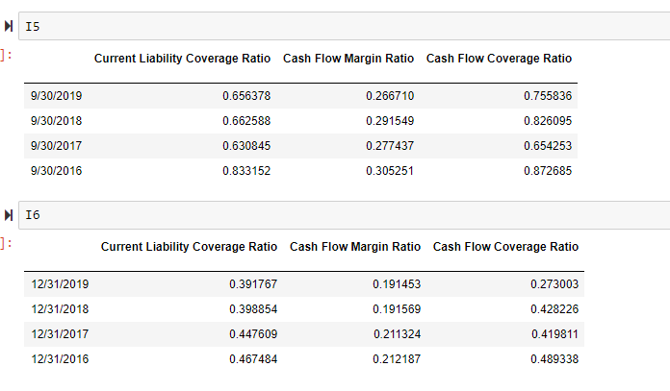
Final Cash Flow statement Results for Apple and IBM respectively

Slide 23
Summary
Here the ability to pay the short term liability of apple is double than IBM liability coverage ratio( 0.264611 difference). The cash flow margin of the Apple is also higher which gives us a clear indication of the good cash flow to the Apple company.
Apple company is also good at transforming sales of their services and products into cash. Cash flow coverage ratio is playing a significant difference in both the companies especially Apple have more than 0.482833 difference than IBM .
So here apple has a better ability to pay of its obligations with its operating cash flows than IBM. So in conclusion Apple has a good cash position than IBM and more liquidity. So that’s the reason why we can consider them as the best in the income statement.

Slide 24
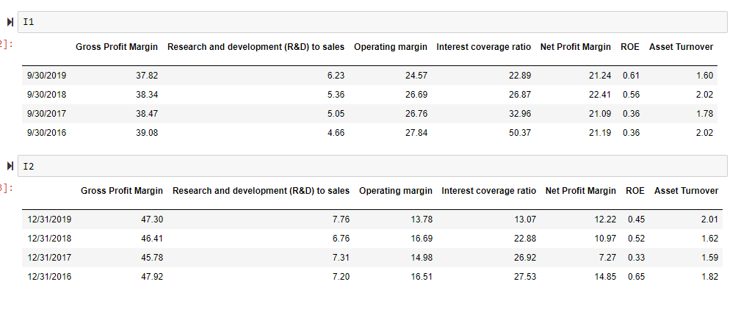
Final Income statement Results for Apple and IBM respectively.

Slide 25
Summary
Gross Profit Management of Apple Inc, is lower than IBM from the last four years. But IBM‘s Research and Development to sales and operating margins is not favorable in the past four years, that is why IBM is failing to maintain the profit at the end.
On the other hand Apple Inc was properly cutting their operating cost and was having a leading profit margin. Apple’s Interest coverage ratio and ROE is favorable but the asset turnover ratio is comparatively low which means that revenue of the IBM is higher but they fail to convert the revenue to profit which is main drawback for them.
Even though Apple is generating less revenue than IBM, but they are good at maintaining all the variable and fixed costs.

Slide 26
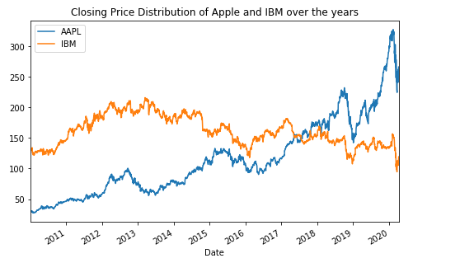
Share Price Distribution over the years.
From this graph its clearly evident that the closing price for Apple was increasing over the years, whereas the closing price for IBM was almost the same over the years with more fluctuations over the years.
From this graph also, its clearly evident that Apple Inc was performing better.

Slide 27
Conclusion
So in all the three financial statement Apple had better ratios.
In comparison with IBM , Apple holds a prominent position in the market.
Apple also has a great cash flow and they are good at controlling their operating cost and turning them into net profit.
Apple also holds less liability than IBM ,so the investors risk is low .
In market ,Apple has a good will and also has a stable growth in the last 10 years as we have seen in the graph and their products easily hits its break even points . So maybe that is why share holders or investors are more confident about Apple even though their share price is higher than IBM.
The working capital of IBM had a huge decrease in 2019 as compared to 2018 may be because of the acquisition of the subsidiary.( Red Hat on October, 2018 ).

Slide 28

So Apple Inc was performing better among all the 4 companies and they are more promising to the future investors.

Slide 29
References
https://www.thebalancesmb.com/cash-flow-ratios-for-analysis-393116
https://www.accountingcoach.com/financial-ratios/explanation/2
https://www.thebalance.com/formulas-calculations-and-ratios-for-the-income-statement-357575
https://www.investopedia.com/terms/f/financial-statement-analysis.asp
https://corporatefinanceinstitute.com/resources/knowledge/finance/analysis-of-financial-statements/

Slide 30

Thank You
Notes:
Source : https://www.google.com/url?sa=i&url=https%3A%2F%2Fwww.dreamstime.com%2Fstock-photo-thank-you-business-team-hands-work-financial-reports-laptop-top-view-image78238196&psig=AOvVaw1Iq_C52bIbShjTelq8tYPk&ust=1586661588371000&source=images&cd=vfe&ved=0CAIQjRxqFwoTCKCIt5y13-gCFQAAAAAdAAAAABAJ

